Slide 1
Escape Room location | RDM challenge | Solution | Code word | Aanpassing
origineel
Address book | What constitutes personal data | Aaron Andersson (H) Jan Janssen (O) Alex Thorne (R) Jane Doe (R) Emily Gilmore (O) S. Cooper (R) Jack Hodgins (S) | Horrors | Linked in profile to partipant data (Rolodex?) Letters on the back of the profiles with blacklightpen
Wall map | Transferring data across borders | Incident 1: 12-09-26 (Azores) Incident 2: GAS-KIN-ASA (Nagasaki +S) Incident 3: 1 (Nowo Sibirsk) Route: Pretoria – Lumbumbashi – Azores – New York – Nagasaki – Irkoetsk – Nowo Sibirsk – Guam | Planning | Location based Follow the professors travel schedule Board with map Agenda?
Notice board | Persistent identifiers | Pablo Colunga-Salas's Orcid is: 0000-0002-1355-0939. This Orcid code identifies the letters on the coded sheet: HELPS. | Helps | Idem, maar dan in print
Filing cabinet | Metadata | 1-2-4-6-8-10-12 Briefcase Code: 712 | Good | Briefcase with number lock Put the puzzle to find the code in a baggagelabel
Camera | FAIR | Finding the USB-stick & watching the video | Data | Put the video on a USB-stick and hide in the waste paper bin
Waste paper bin | Preserving data |  | Avoid | Word seeker

Slide 2
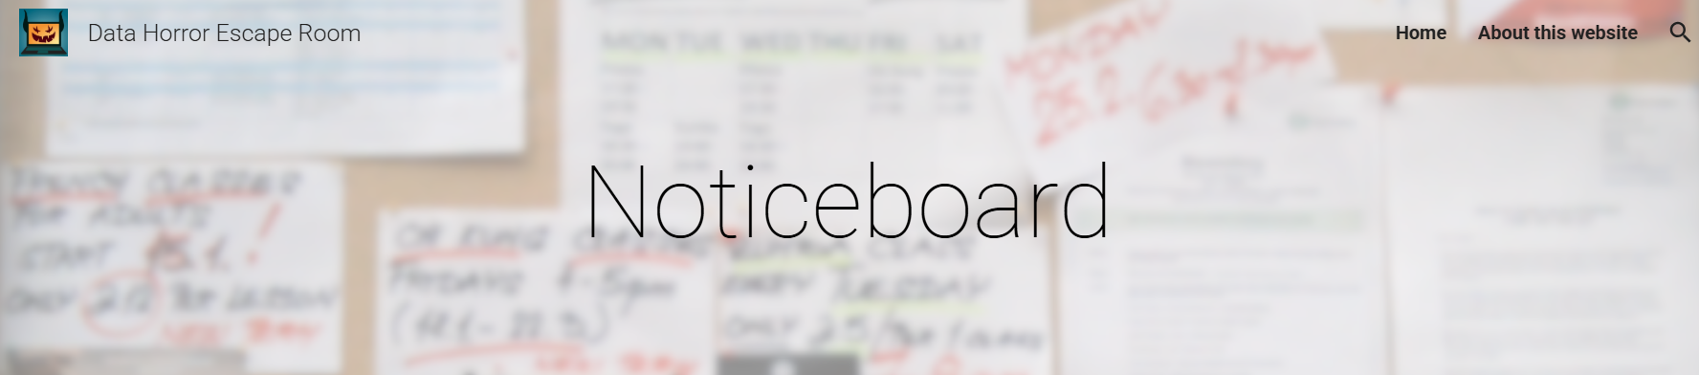
Sectie Noticeboard

Slide 3
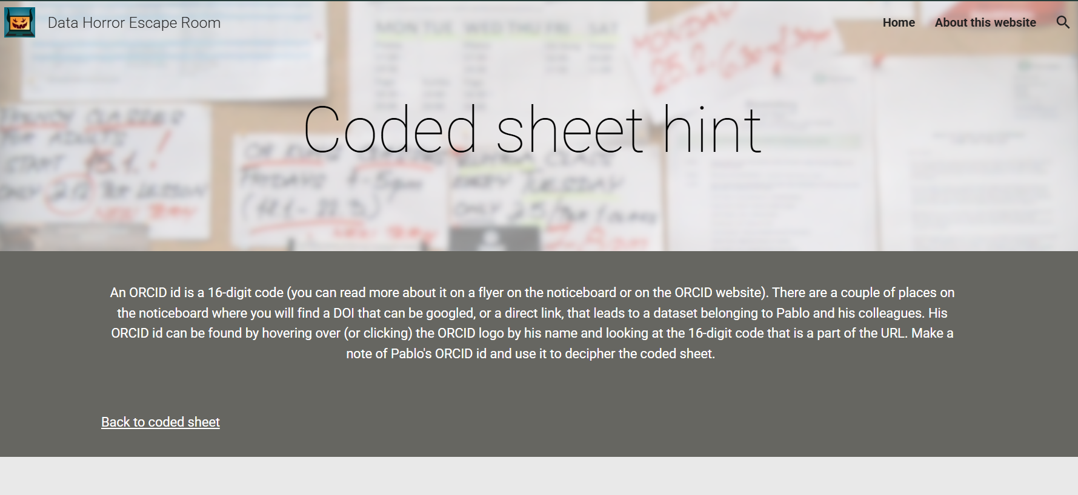

Slide 4


Slide 5
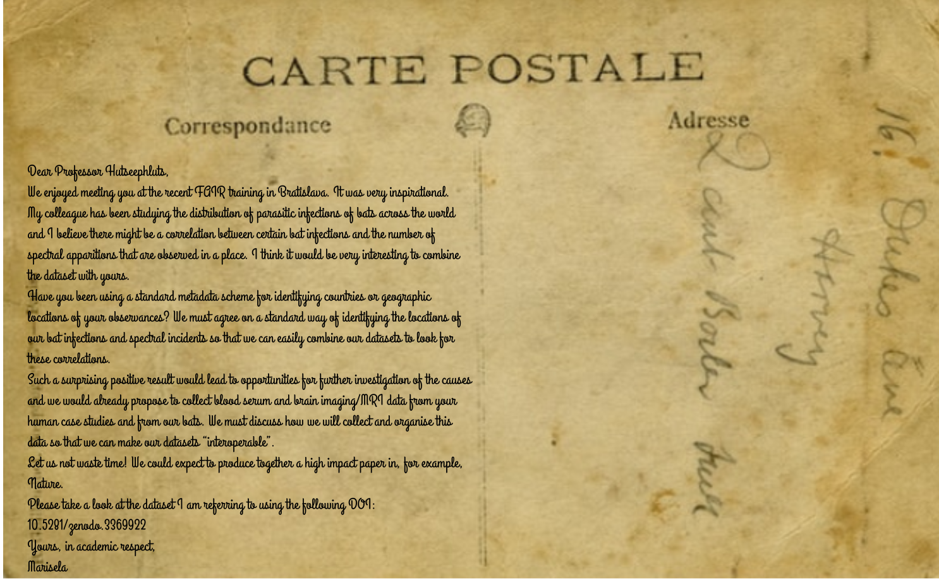

Slide 6


Slide 7
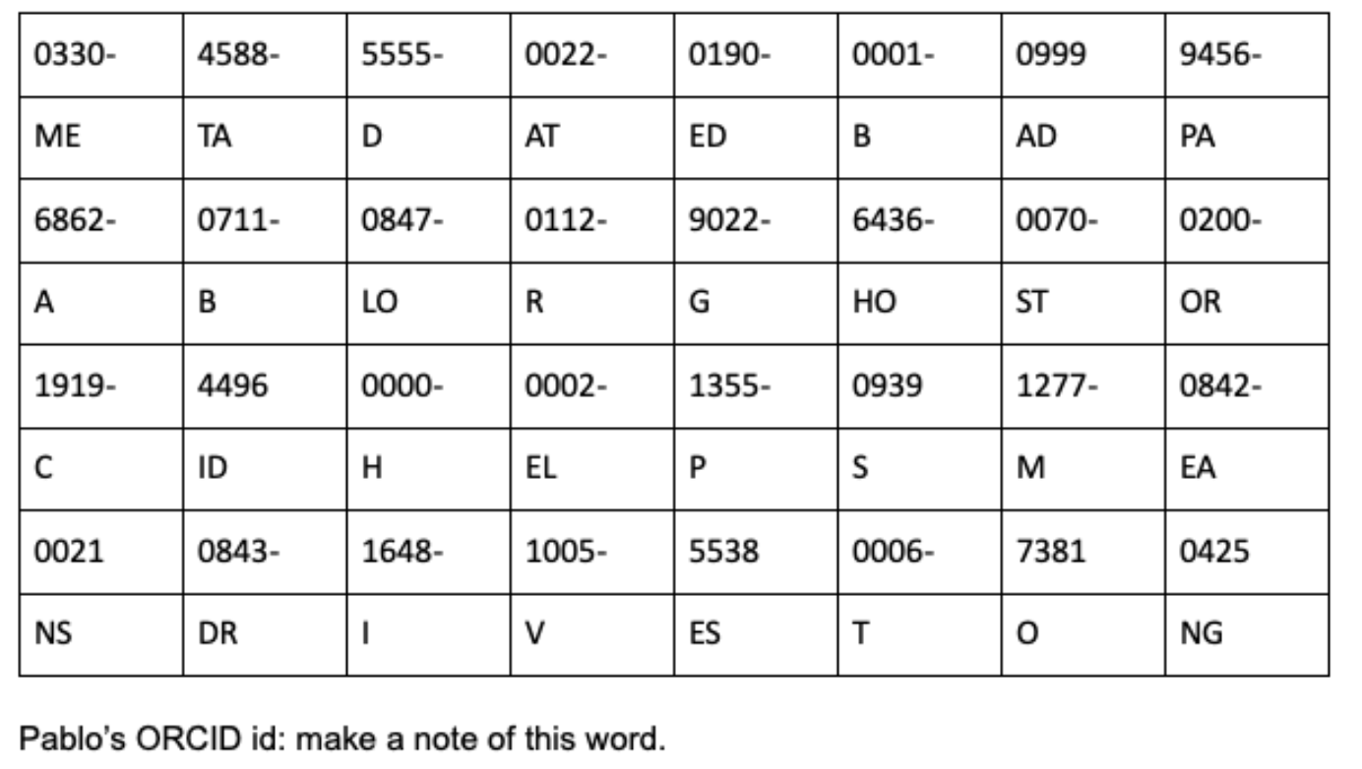

Slide 8
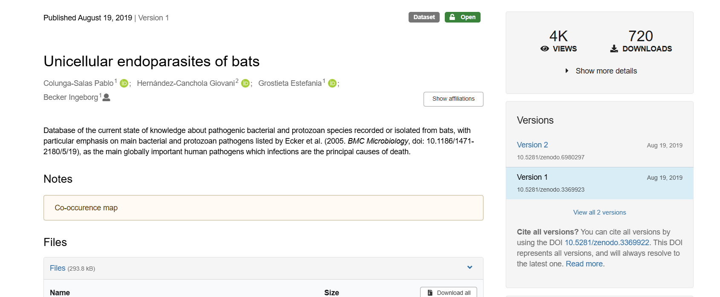

Slide 9
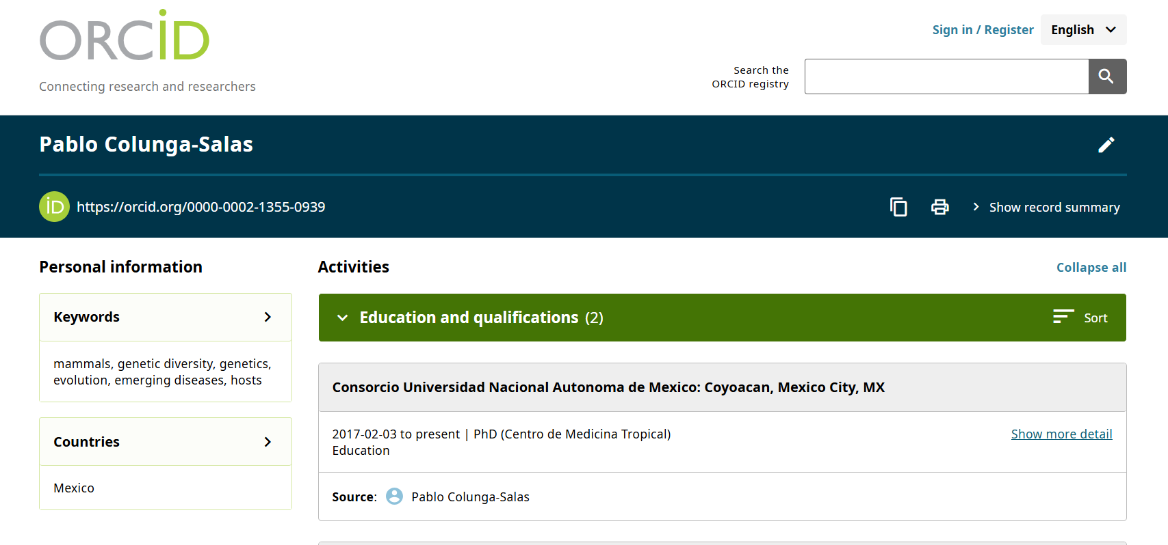

Slide 10
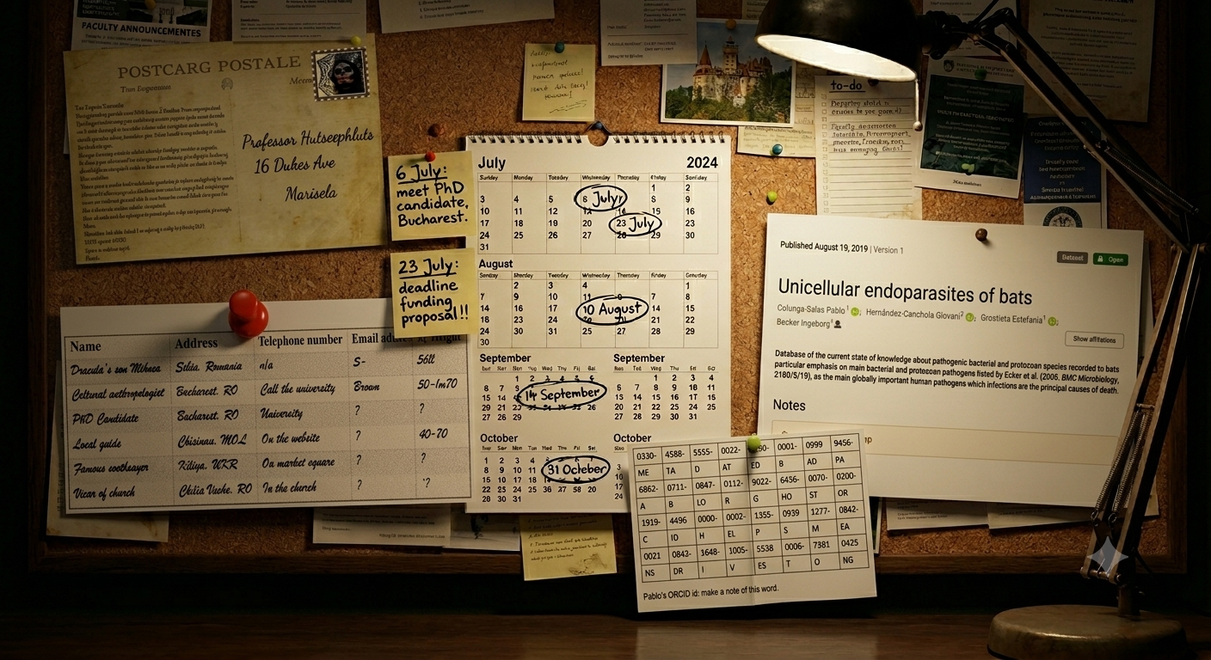

Slide 11

The Professor might have left the office open, but at least the computer is locked so no-one can mess with his files.
Maybe the computer offers a way out of the office. But... you need a password... how and where can you find it?

Slide 12
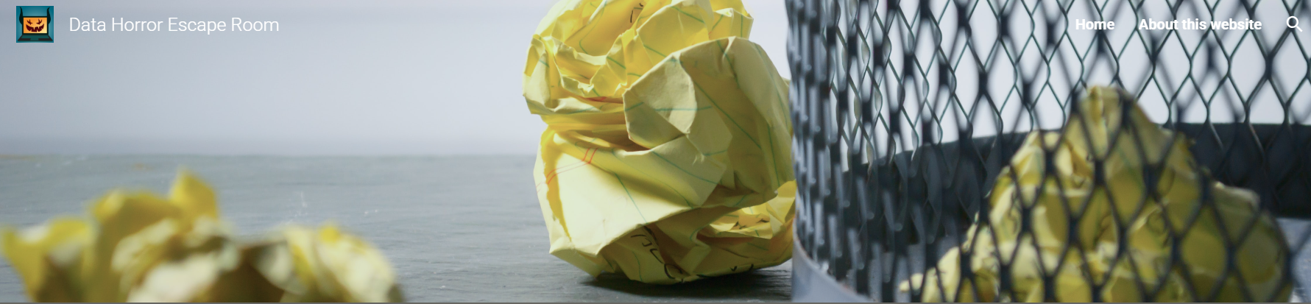
Waste paper bin

Slide 13
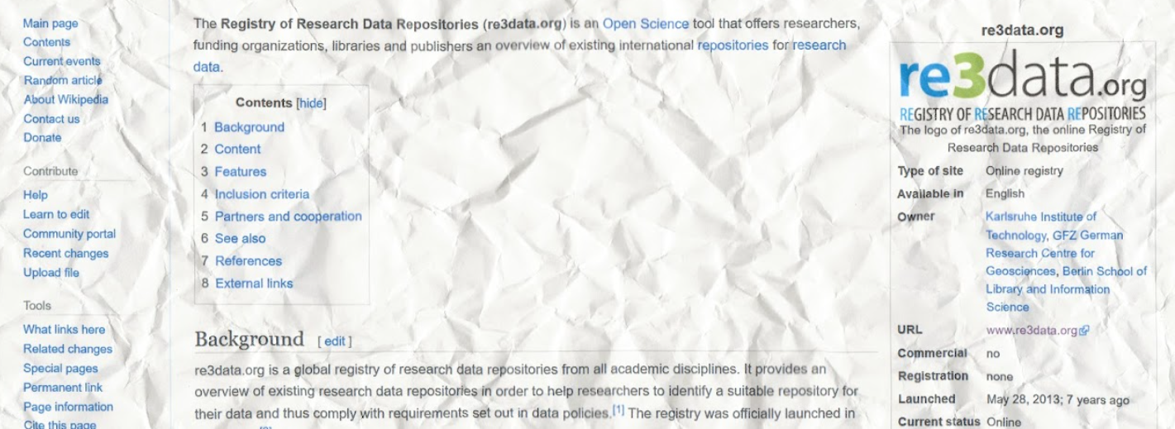

Slide 14
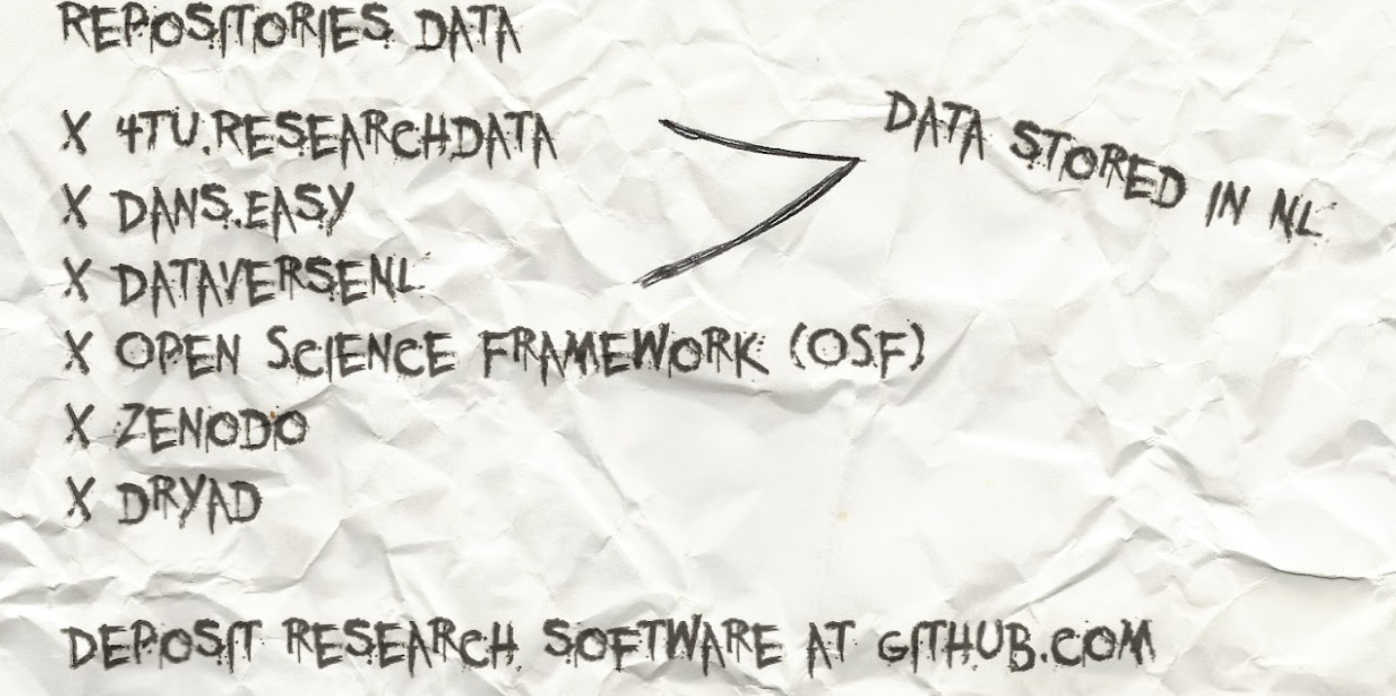

Slide 15
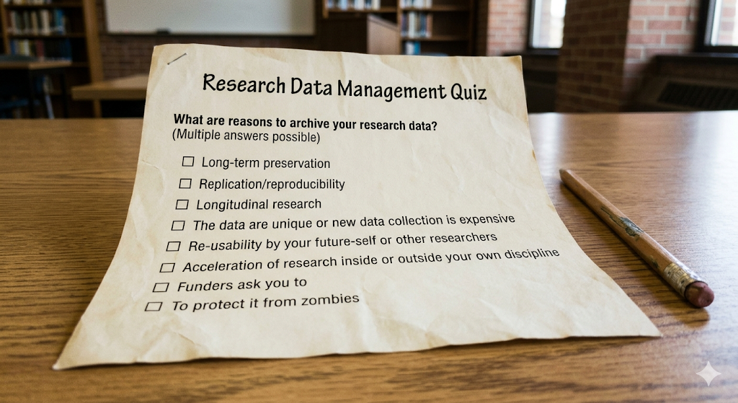

Slide 16
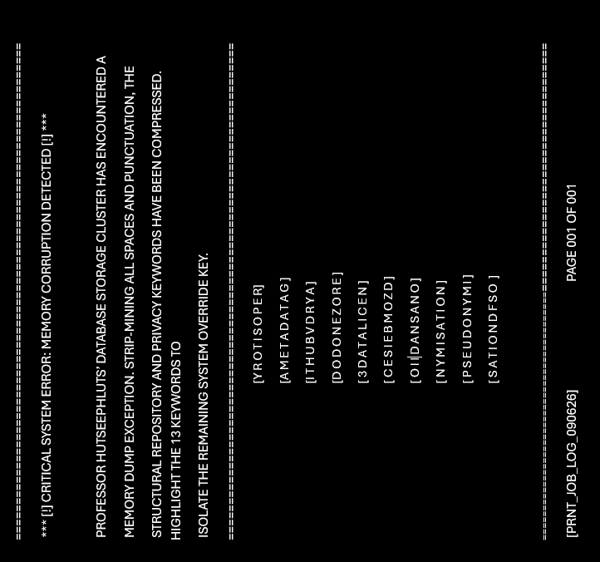

Slide 17
database infrastructure that compiles, manages and gives
access to data and associated metadata and documentation
The European general repository operated by CERN
Open science framework
de-identification procedure
A repository that explicitly stores data locally in the Netherlands
website that can be used find a suitable data repository for your discipline.
What must minimally be added to data to clarify terms of legal re-use
An example of a Persistent Identifier
Data about data
When I say “push” , “pull”, you say…
prevent re-identification of individuals within the dataset
It’s in your head

Slide 18
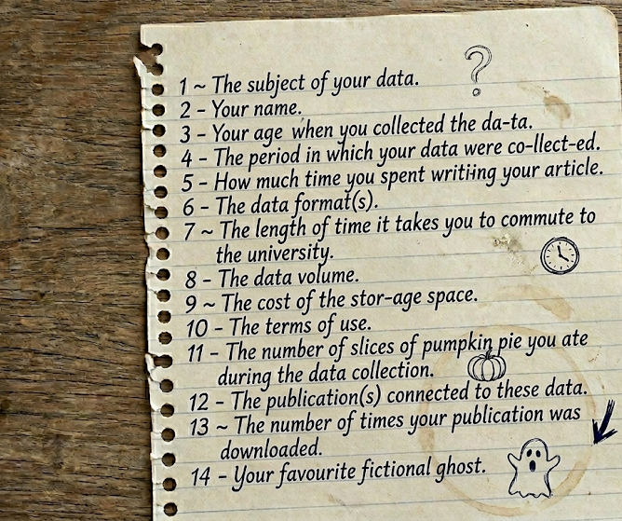
Can you crack the code of the briefcase by indicating which details about your research would be necessary for a PhD candidate to download, understand, interpret and use your data? Write your answer as 1-2-3-4... Then use the number of necessary details, the first detail and the last digit of the final detail to open the briefcase.
Notes:
Linked to book succesfful presentation skills

Slide 19


Slide 20


